Slide 1
Appendix B
Object-Oriented Design

Slide 2
Overview of Object Orientation
An object is a fundamental entity of object-oriented programming.
A class is a definition of a data type that has state and behavior.
An object is an instance of a class.
Each object has it’s own properties (state) separate from other objects of the same class. This is encapsulation.
A class can be defined from another class using inheritance.
Polymorphism is where an object of a parent class behaves like an object of a child class.

Slide 3
Using Objects
Abstraction
An abstraction hides details.
A good abstraction hides the right details at the right time so that we can manage complexity.
In OOP, objects provide abstraction.
Creating Objects
Variable is either primitive or reference
The new operator returns a reference to a newly created (instantiated) object
SomeClass obj = new SomeClass();

Slide 4
Using Objects
Calling methods
The dot operator is used to call methods
obj.doSomething();
C++
SomeClass obj();
obj.doSomething();
SomeClass* pObj = new SomeClass();
pObj->doSomething();

Slide 5
Class Libraries and Packages
The Java standard class library is a useful set of classes that anyone can use when writing Java programs.
A package is a Java language element used to group related classes under a common name.
The import declaration
All classes in the java.lang package are automatically available
To use other classes, either fully qualify the reference or use an import declaration
java.util.Random r = new java.util.Random();
OR
import java.util.Random;
Random r = new Random();

Slide 6
Class Libraries and Packages
C++
Standard template library
#include

Slide 7
State and Behavior
Each object has a state and a set of behaviors.
The values of an object’s variables define its state.
The methods to which an object responds define its behaviors.

Slide 8
Classes
A class is a blueprint for an object; it reserves no memory space for data.
Each object has its own data space and thus its own state.
Class members
Instance variables (non-static)
Instance methods (non-static)
The scope of a variable, which determines where it can be referenced, depends on where it is declared.
Variables declared inside a method are called local variables.

Slide 9
Classes
public class Coin { // Java
private final int HEADS = 0;
private final int TAILS = 1;
private int face;
public Coin() {
flip();
}
public void flip() {
face = (int)(Math.random() * 2);
}
public boolean isHeads() {
return (face == HEADS);
}
public String toString() {
String faceName;
if( face == HEADS )
faceName = “Heads”;
else
faceName = “Tails”;
return faceName;
}
}
class Coin { // C++
private:
const int HEADS = 0;
const int TAILS = 1;
int face;
public:
Coin();
void flip();
bool isHeads();
friend std::iostream& operator<<(std::ostream& os, const Coin& rhs);
}
Coin::Coin() {
srand();
flip();
}
void Coin::flip() {
face = rand() % 2;
}
bool Coin::isHeads() {
return (face == HEADS);
}
Std::ostream& operator<<(std::ostream& os, const Coin& rhs) {
if( face == HEADS )
os << “Heads”;
else
os << “Tails”;
return os;
}

Slide 10
Encapsulation
Objects should be encapsulated.
The rest of a program should interact with an object only through a well-defined interface.
Visibility modifiers
public: can be directly reference outside of the object
private: can only be referenced inside the object
protected: used in inheritance to create private-like members that can be referenced by child classes
A variable declared in a method is local to that method and cannot be used outside of it.

Slide 11
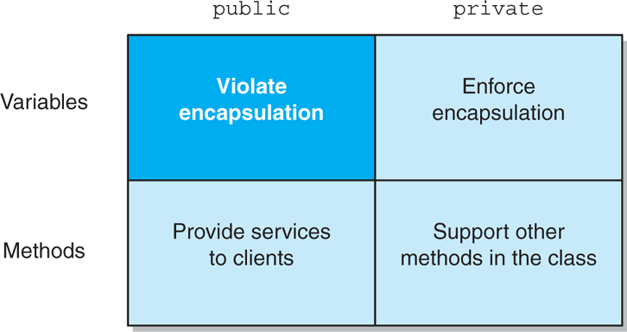
Encapsulation

Slide 12
Constructors
A constructor is used to initialize an object.
The name of the constructor is the same as the name of the class.
A constructor cannot have a return type, not even void.
If no constructor is defined, then a default constructor is provided.
Destructor
Java does not have a destructor like C++ does.
While constructors can be overloaded, the C++ destructor cannot be overloaded
The name of the destructor is the class name with a tilde (~) in front.
Java does not have a destructor but it does have a finalize method that can be overloaded.

Slide 13
Method Overloading
The versions of an overloaded method are distinguished by their signatures.
The number, type, or order of the parameters must be distinct.

Slide 14
References Revisited
Java: An object reference variable stores the address of an object.
C++: A pointer variable stores the address of an object.
With a few exceptions, we can treat Java object reference variables and C++ pointer variables the same
There are some syntax differences
A reference variable that does not currently point to an object is called a null reference
Java: The reserved word null represents a reference that does not point to a valid object
C++: The reserved word nullptr represents a pointer that does not point to a valid object (does not contain a valid memory address).

Slide 15
References Revisited
The this reference always refers to the currently executing object.
Aliases
Several references can refer to the same object. These references are called aliases of each other.
The == operator compares object references for equality, returning true if the references are aliases of each other.
The equals method can be defined to determine equality between objects in any way we consider appropriate.
C++ does not have a built in equals method. An equals method could be defined or more commonly the == operator is overloaded.
Java does not have operator overloading.

Slide 16
References Revisited
Garbage Collection
If an object has no references to it, a program cannot use it.
Java performs automatic garbage collection by periodically reclaiming the memory space occupied by these objects.
C++ does not have automatic garbage collection. The programmer is responsible for deallocating memory when the object is no longer needed.
SomeClass* obj = new SomeClass();
// use the object
delete obj;

Slide 17
References Revisited
Passing Objects as Parameters
When an object is passed to a method, the actual and formal parameters become aliases of each other.

Slide 18
The static Modifier
The static modifier associates a variable or method with its class rather than an object of the class.
Static Variables
A static variable is shared among all instances of a class.
Constants, which are declared using the final modifier, are also often declared using the static modifier as well.
Static Methods
A method is made static by using the static modifier in the method declaration.
Static methods can only access static variables.

Slide 19
Wrapper Classes
A wrapper class represents a primitive value so that it can be treated as an object.

Slide 20
Interfaces
An interface is a collection of constants and abstract methods. It cannot be instantiated.
A class implements an interface, which formally defines a set of methods used to interact with objects.
interface Complexity {
void setComplexity(int complexity);
int getComplexity();
}
class Questions implements Complexity {
int difficulty;
// other stuff
void setComplexity(int complexity) {
difficulty = complexity;
}
int getComplexity() {
return difficulty;
}
}

Slide 21
Interfaces
C++ does not have interfaces. Instead use an abstract class.
class Complexity {
void setComplexity(int complexity)=0;
int getComplexity()=0;
};
class Questions : public Complexity {
int difficulty;
// other stuff
void setComplexity(int complexity) {
difficulty = complexity;
}
int getComplexity() {
return difficulty;
}
};
Java does not allow multiple inheritance but it does allow multiple implements
C++ allows multiple inheritance

Slide 22
Inheritance
Inheritance is the process of deriving a new class from an exitsting one.
One purpose of inheritance is to reuse existing software.
Derived Classes
Inherited variables and methods can be used in the derived class as if they had been declared locally.
The original class that is used to derive the new one is called the parent class, superclass, or base class.
The derived class is called the child class or subclass.
Inheritance creates an is-a relationship between all parent and child classes.

Slide 23
Inheritance
Java
class Book {
protected int numPages;
protected void pages() {
System.out.println(“Number of pages: “ + numPages);
}
}
class Dictionary extends Book {
private int numDefs;
public void info() {
System.out.println(“Number of definitions: “ + numDefs);
System.out.println(“Definitions per page: “ + numDefs / numPages);
}
}

Slide 24
Inheritance
C++
class Book {
protected:
int numPages;
void pages() {
cout << “Number of pages: “ << numPages << endl;
}
};
class Dictionary : public Book {
private:
int numDefs;
public:
void info() {
cout << “Number of definitions: “ << numDefs << endl;
cout << “Definitions per page: “ << (numDefs / numPages) << endl;
}
};

Slide 25
Inheritance
The protected Modifier
Visibility modifiers determine which variables and methods are inherited.
Private members are not inherited.
Public members are inherited but break encapsulation for variables.
Constructors are not inherited even if they are public.
Protected visibility provide encapsulation and permits inheritance.
The super Reference
Java: A parent’s constructor can be invoked using the super reference.
C++: To invoke the parent constructor call the constructor in initialization list.

Slide 26
Inheritance
Overriding Methods
A child class can override (redefine) the parent’s definition of an inherited method.

Slide 27
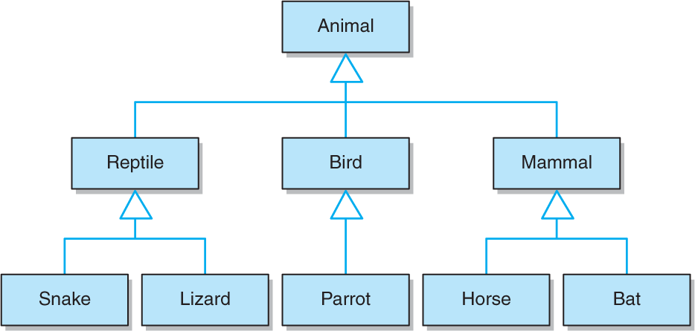
Class Hierarchies
The child of one class can be the parent of one or more other classes, creating a class hierarchy.
Common features should be located as high in a class hierarchy as is reasonable, in order to minimize maintenance efforts.

Slide 28
Class Hierarchies
The Object Class
All Java classes are derived, directly or indirectly, from the Object class.
The toString and equals methods are defined in the Object class and therefore are inherited by every class in every Java program.
C++ has no equivalent concept of an Object class.
Abstract Classes
An abstract class cannot be instantiated.
It represents a concept on which other classes can build their definitions.
A class derived from an abstract parent must override all of its parent’s abstract methods, or the derived class will also be considered abstract.

Slide 29
Class Hierarchies
Interface Hierarchies
Inheritance can be applied to interfaces so that one interface can be derived from another interface.
An interface cannot inherit from a class and a class cannot inherit from an interface.

Slide 30
Polymorphism
A polymorphic reference can refer to different types of objects over time.
Binding is when a method invocation is matched to the method definition.
Early binding or compile-time binding occurs when the code is compiled.
Late binding or run-time binding occurs while the program is running.
Polymorphism allows run-time binding.

Slide 31
Polymorphism
References and Class Hierarchies
A reference variable can refer to any object created from any class related to it by inheritance.
The type of the reference variable is called the declared type.
The type of the object is called the actual type.
Polymorphism via Inheritance
A polymorphic reference uses the type of the object, not the type of the reference, to determine which version of a method to invoke.

Slide 32
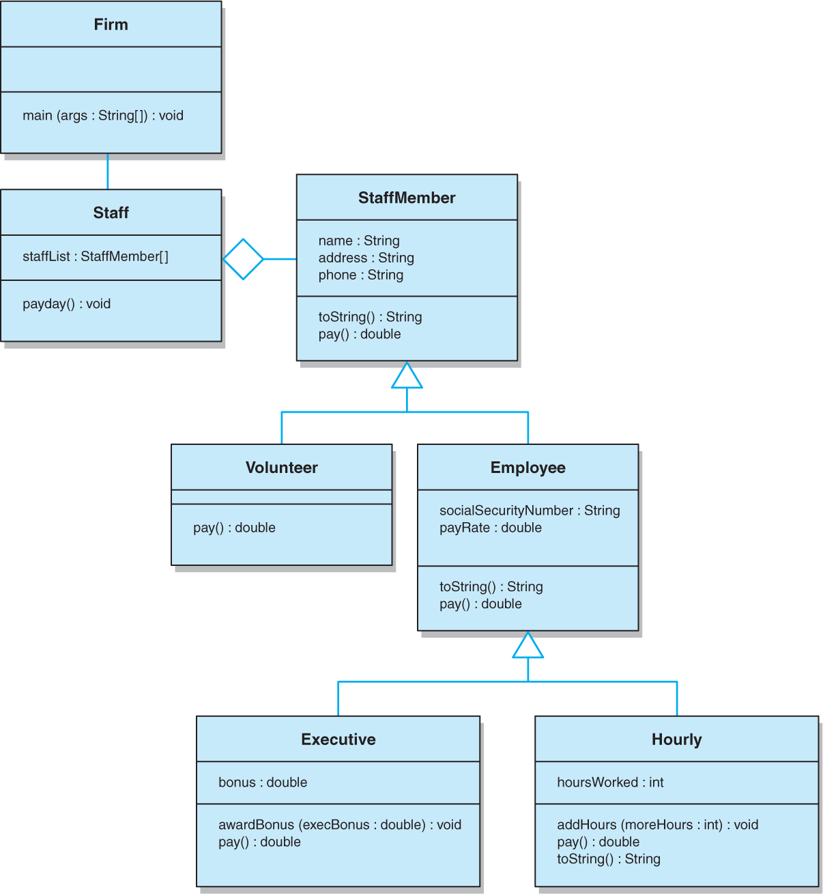
Polymorphism

Slide 33
Polymorphism
Polymorphism via Interfaces
An interface name can be used to declare an object reference variable.
An interface reference can refer to any object of any class that implements the interface.
Interfaces enable us to make polymorphic references in which the method that is invoked is based on the particular object being referenced at the time.

